Slide 1
PREDICTION OF STOCK MARKET PRICES
Shishir Kumar - TCS15B027
Mehar Chaturvedi - TCS15B019

Slide 2
METHODOLOGY
Acquisition of Knowledge about the factors affecting the current stock prices
processing of data to reduce features to only adj. open,adj. high, adj.low,adj. close, adj. volume
Creating new feature like percentage change and variation of stock market in one day
Fitting the training data into the model and predicting the outcome by applying it on testing dataset.
Splitting the dataset into training and testing dataset
Creating label which is the prediction of the stock in the near future.

Slide 3
BACKGROUND
Stock market prices area function of information and rational expectations and any changes in the company’s prospects is immediately reflected in its current prices.
Stock prices cannot be determined by past history and the best way to describe them is through the stochastic process called Random Walk meaning each day’s price deviation from central value is unpredictable !
We looked into the following terms to get a hold on the essential features required to train and test data:

Slide 4
BACKGROUND
Adjusted Closing Price : Stock’s closing price on any given day of trading to include and corporate actions prior to to the next day’s open . Corporate actions may include dividends , rights offerings and stock splits (typically to make its share prices more marketable)
Opening Price : Prices at which security first trades upon opening of an exchange on a given day.
Adjusted High Price : the highest price of the stock at which the stock traded during the entire day.
Adjusted low Price: the lowest closing price of the stock at which the stock traded during the entire day.

Slide 5
PROJECT WORK
Acquisition of dataset on Tesla company from quandl .
Taking into consideration the following features : Adjusted Closing Price , Adjusted open price, Adjusted low price and Adjusted high price.
Our main focus is on Adjusted Closing Price for stock market price prediction.
we have used a two models Linear regression and Neural Network model to get the best fit for our data.
We have divided our data into training and testing set.
In linear regression model, we have added a column called ‘label’ that includes the future value of the stock market price price 20 days from the current stock market price . This is how we were able to get most of our training data.

Slide 6
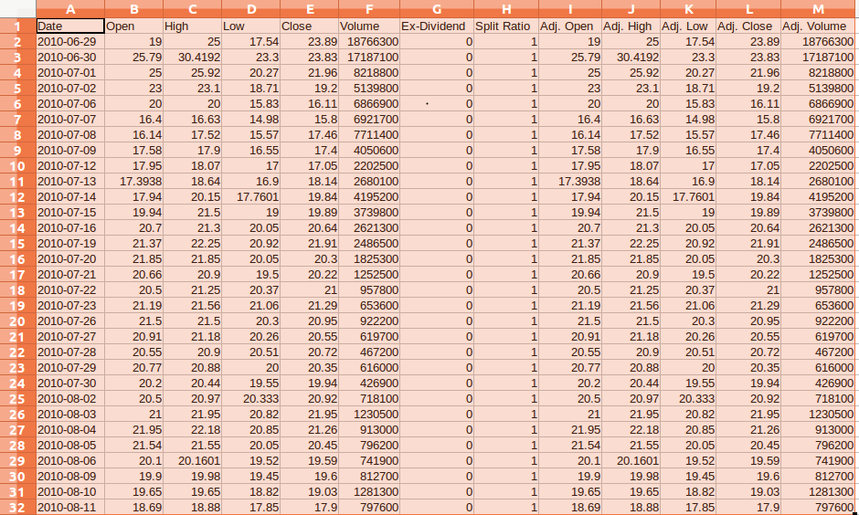
Acquired data from Quandl

Slide 7
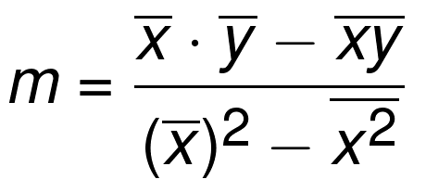

Linear Regression model
Formula for calculating slope
Formula for calculating y intercept

Slide 8
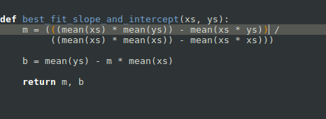
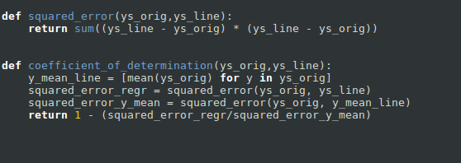
Overview of Code for Linear Regression Model

Slide 9
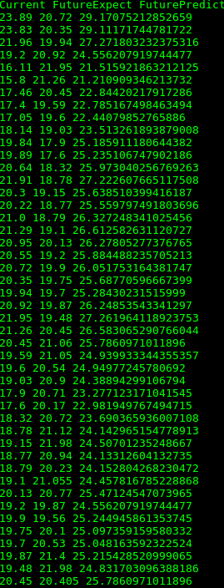
Console outputs

Slide 10
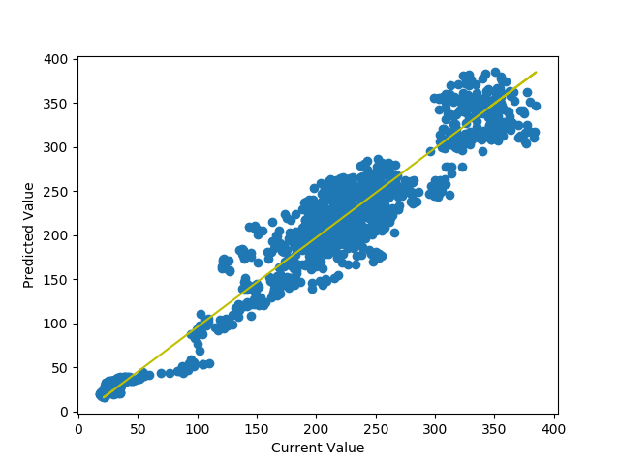

Slide 11
Linear Regression Model
We have calculated to confidence level and coefficient of determinant to see how well our output curve fits the data.
We were able to get 96.3932 % confidence .
We were able to get coefficient of determination =96.16.59%

Slide 12
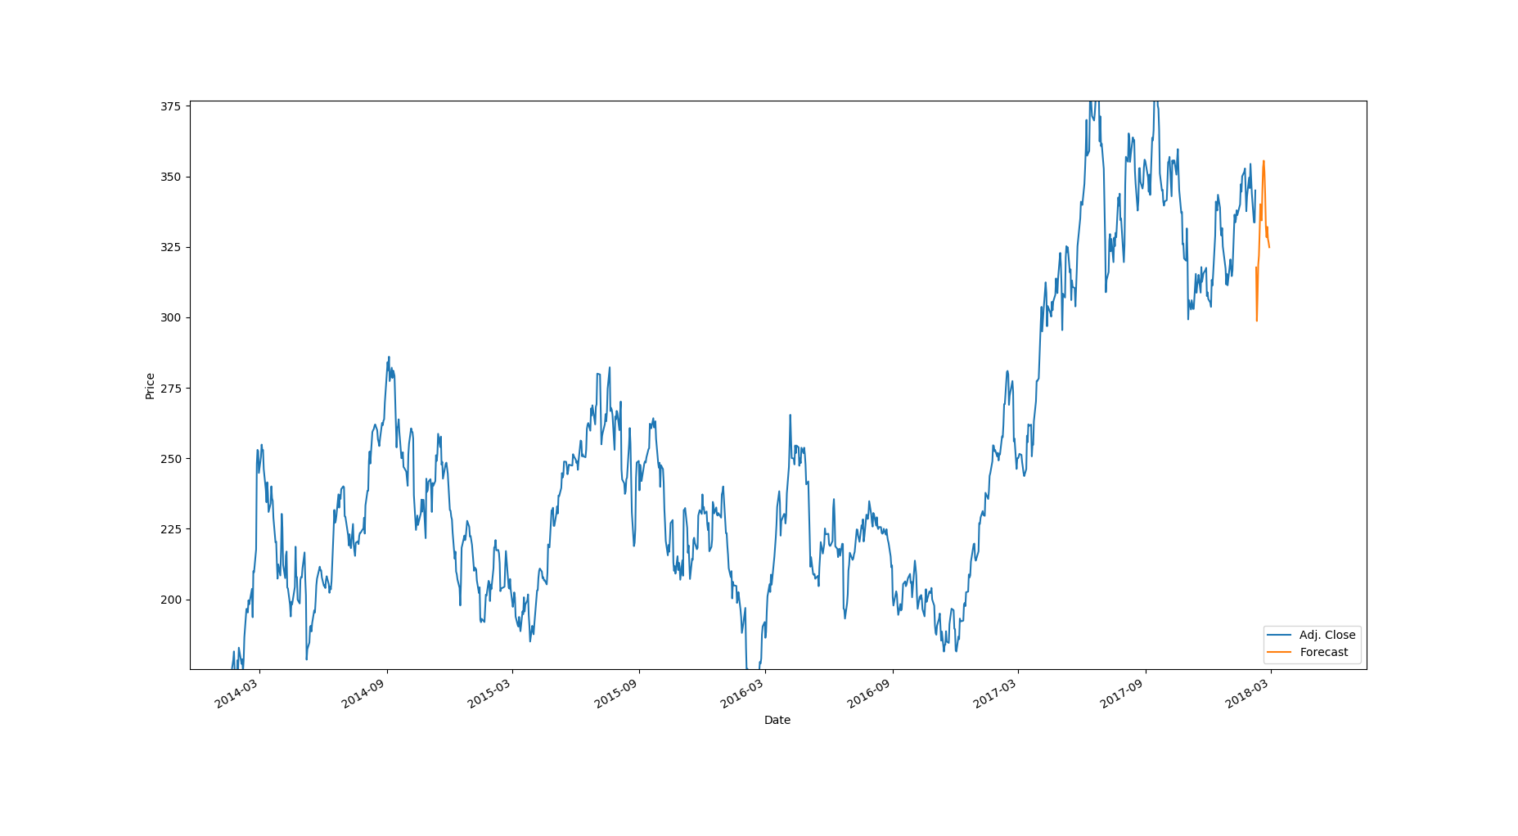
PROJECT WORK
Given below is output that shows how our forecasted market price.

Slide 13
Neural Network model
In neural network model, the adj. Close of last n days were taken as the n features as input where n is a small positive integer.
We took n to be 5.
2 hidden layers were taken while output layer consisted of 1 neuron.
Input layer consisted of n neurons.
We experimented on a range of neuron numbers.
The error was calculated in the form of mean square error.

Slide 14
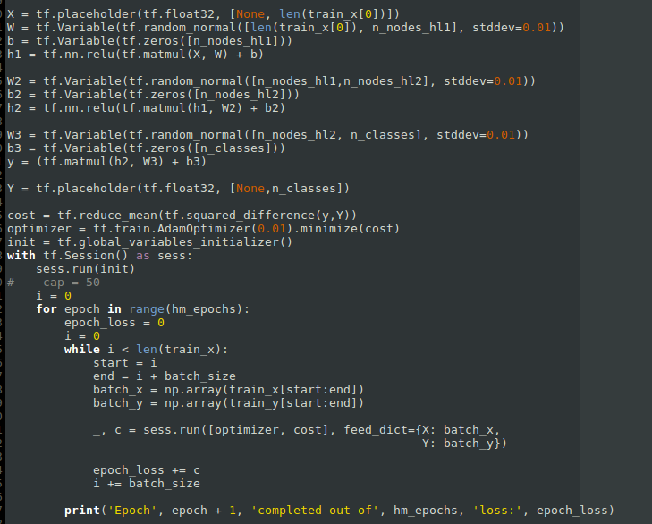
Overview of Code for Neural Network Model

Slide 15
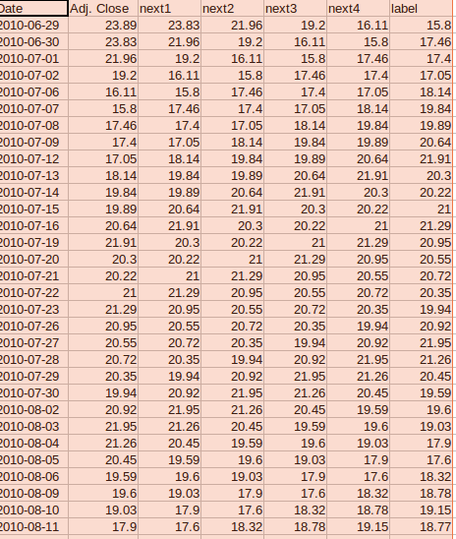
Processed data for neural network model

Slide 16
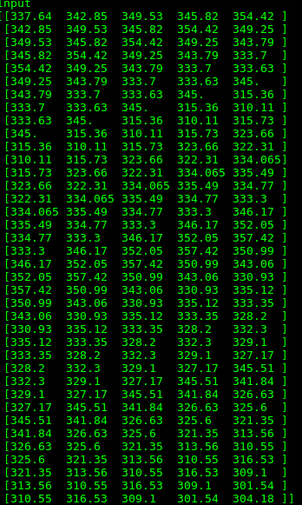
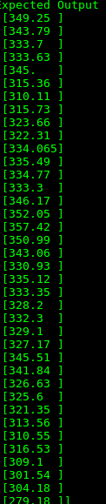
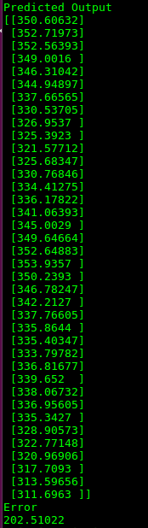
Console output

Slide 17
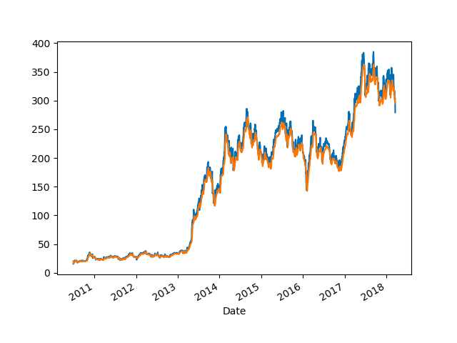

Slide 18
Other Plans for Implementations
To get more data from different companies.
To fit different models like logistic regression,state vector machine,neural network, lasso and ridge regression to given datasets.
To compare the various models and pick the best model among them.
Tried to add twitter sentiment analysis in the project.

Slide 19
REFERENCES
L. Q. Yu and F. S. Rong, "Stock Market Forecasting Research Based on Neural Network and Pattern Matching," 2010 International Conference on E-Business and E-Government, Guangzhou, 2010, pp. 1940-1943.
Manna Majumder, Anwar Hussain, “Forecasting of Indian Stock market Index using Artificial Neural network”
Rajput,Vivek and Sarika Sanjay Bobde. “Stock Market Forecasting Techniques: Literature Survey.”(2016).
Quandl
Investopedia
Wikipedia.com

